Slide 1
Programmable Processors

Slide 2
Programmable Processors
So far we’ve looked at ‘hard-wired’ or special purpose processors (like the SAD processor).
We’ll now look at programmable processors or ‘stored program’ processors.
Different tasks can be performed by changing the program.
Well-known examples: Pentium, PIC, ARM, Atmel AtMega, MIPS

Slide 3
Datapath Side
addr
Data Memory
w_en
Takes data from Data Memory
Stores it in Register File
Operates on it in ALU (puts it back into the Register File)
Can store Register File data back into Data Memory
Note the dual output Register File
We’ve built every piece of this already
n
n
n-bit
2-1 Mux
n
select
n
write, read
controls
Register File
n
n
function
select
ALU
Datapath
From F. Vahid’s Digital Design

Slide 4
Basic Datapath Operations
Data memory D
Data memory D
Data memory D
n-bit
n-bit
n-bit
2x
1
2x
1
2x
1
Register file RF
Register file RF
Register file RF
ALU
ALU
ALU
LOAD operation
ALU operation
(like an ADD)
STORE operation
D[9] = D[0] + D[1] – requires a sequence of four datapath operations:
0: RF[0] = D[0]
1: RF[1] = D[1]
2: RF[2] = RF[0] + RF[1]
3: D[9] = RF[2]
Each line here represents
one instruction; so it takes
four instructions to do this
add
LOAD
LOAD
ADD
STORE
From F. Vahid’s Digital Design

Slide 5
Basic Architecture – Control Unit
D[9] = D[0] + D[1] – requires a sequence of four datapath operations:
0: RF[0] = D[0]
1: RF[1] = D[1]
2: RF[2] = RF[0] + RF[1]
3: D[9] = RF[2]
Each operation is an instruction
Sequence of instructions = program
Looks cumbersome, but that's the world of programmable processors – Decomposing desired computations into processor-supported operations
Store program in Instruction memory
Control unit reads each instruction and executes it on the datapath
PC: Program counter – address of current instruction
IR: Instruction register – current instruction
RF = Register File
D = Data Memory
Instruction memory
0: RF[0]=D[0]
Data memory D
a
1: RF[1]=D[1]
2: RF[2]=RF[0]+RF[1]
3: D[9]=RF[2]
n-bit
2
x
1
PC
IR
Register file RF
Controller
ALU
Control unit
Datapath
From F. Vahid’s Digital Design

Slide 6
The Size of Things
Data memory (RAM): 256 X 16
Register file: 16 X 16 (dual output)
ALU: Two 16-bit inputs, 16-bit output
Instruction memory (ROM):32 X 16

Slide 7
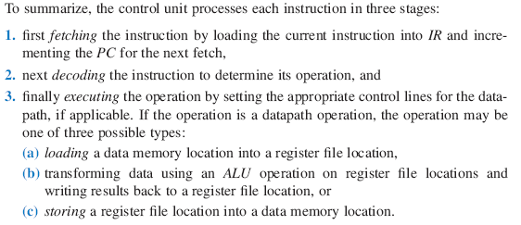
Basic Architecture – Control
State Machine
Instruction memory
I
0: RF[0]=D[0]
Data memory D
1: RF[1]=D[1]
2: RF[2]=RF[0]+RF[1]
3: D[9]=RF[2]
n-bit
2
x
1
PC
IR
Register file RF
Controller
ALU
Control unit
Datapath
From F. Vahid’s Digital Design

Slide 8
Six-Instruction Processor
Instruction Set – List of allowable instructions and their representation in memory
Each of our instructions is 16 bits long
Most of them contain some address information
General form : operation source destination
NOOP instruction – 0000 0000 0000 0000
STORE instruction – 0001 r₃r₂r₁r₀ d₇d₆d₅d₄d₃d₂d₁d₀
LOAD instruction – 0010 d₇d₆d₅d₄d₃d₂d₁d₀ r₃r₂r₁r₀
ADD instruction – 0011 ra₃ra₂ra₁ra₀ rb₃rb₂rb₁rb₀ rc₃rc₂rc₁rc₀
SUBTRACT instruction – 0100 ra₃ra₂ra₁ra₀ rb₃rb₂rb₁rb₀ rc₃rc₂rc₁rc₀
HALT instruction – 0101 0000 0000 0000
‘r’s are Register File locations (4 bits each)
‘d’s are Data Memory locations (8 bits each)

Slide 9
NOOP Instruction
0000 0000 00000000
Always starts with 0000 (and contains nothing but zeros)
Actually is just 0000 xxxx xxxxxxxx, since the 12 bits following 0000 are ignored.
NoOp = No Operation
Just takes up space (or time)
Does not involve the Datapath
If your program starts executing a string of 0s, nothing (too) bad will happen.

Slide 10
STORE Instruction
0001 r₃r₂r₁r₀ d₇d₆d₅d₄d₃d₂d₁d₀
Always starts with 0001
r₃r₂r₁r₀ is a 4-bit Register File address (source)
d₇d₆d₅d₄d₃d₂d₁d₀ is a Data Memory address (destination)
Moves 16 bits of data from the Register File to Data Memory
Example: 0001 1111 0010 1001b (or 0x1F29) means “move the data at Register File 0xF (15d) to Data Memory location 0x29 (41d)

Slide 11
LOAD Instruction
0010 d₇d₆d₅d₄d₃d₂d₁d₀ r₃r₂r₁r₀
Always starts 0010
d₇d₆d₅d₄d₃d₂d₁d₀ is a Data Memory address (source)
r₃r₂r₁r₀ is a 4-bit Register File address (destination)
Moves 16 bits of data from Data Memory to the Register File
Example : 0010 00001010 0111b (or 0x20A7) means “move the data at Data Memory location 0x0A (10d) to Register File 7.”

Slide 12
ADD Instruction
0011 ra₃ra₂ra₁ra₀ rb₃rb₂rb₁rb₀ rc₃rc₂rc₁rc₀
Always starts with 0011
ra₃ra₂ra₁ra₀ is a 4-bit Register File address (source for A)
rb₃rb₂rb₁rb₀ is a 4-bit Register File address (source for B)
rc₃rc₂rc₁rc₀ is a 4-bit Register File address (destination)
Adds the 16 bits of A to 16 bits of B, stores the result in C (all these in the Register File)
Example: 0011 0001 0010 0011b (or 0x3123) adds the data at Register File 1 to the data at Register File 2 and stores the result in Register File 3.

Slide 13
SUBTRACT Instruction
0100 ra₃ra₂ra₁ra₀ rb₃rb₂rb₁rb₀ rc₃rc₂rc₁rc₀
Always starts with 0100
ra₃ra₂ra₁ra₀ is a 4-bit Register File address (source for A)
rb₃rb₂rb₁rb₀ is a 4-bit Register File address (source for B)
rc₃rc₂rc₁rc₀ is a 4-bit Register File address (destination)
Subtracts the 16 bits of B from the 16 bits of A, stores the result in C (all these in the Register File)
Example: 0100 0001 0010 0011b (or 0x4123) subtracts the data at Register File 2 from the data at Register File 1 and stores the result in Register File 3.

Slide 14
HALT Instruction
0101 0000 00000000
Always starts 0101 and remainder is all 0s
Actually is 0100 xxxx xxxxxxxx, since all the bits following 0101 are ignored
Causes the processor to just stop (hard stop)
You need to reload it or reset it to get it going again.
Does not involve the Datapath

Slide 15
First Program
Our program:
0: RF[0] = D[0]
1: RF[1] = D[1]
2: RF[2] = RF[0] + RF[1]
3: D[9] = RF[2]
4: HALT
Becomes: LOAD 0 0 or 0010 00000000 0000b LOAD 1 1 or 0010 00000001 0001b ADD 0 1 2 or 0011 0000 0001 0010b STORE 2 9 or 0001 0010 00001001b HALT or 0101 0000 00000000b
This is what gets stored in Instruction Memory
0x2000
0x2011
0x3012
0x1209
0x5000

Slide 16
The Register File (from HW6)
Write
Enable
Write
Addr
Write
Data
4
16
Read-A Enable
Register File
Read-A Addr
4
Read-B Enable
Read-B Addr
4
Clock
Reset
16
16
A Data
B Data

Slide 17
The ALU (from HW6)
// This ALU has eight functions:
// if s == 0 the output is 0
// if s == 1 the output is A + B
// if s == 2 the output is A – B
// if s == 3 the output is A (pass-through)
// if s == 4 the output is A ^ B
// if s == 5 the output is A | B
// if s == 6 the output is A & B
// if s == 7 the output is A + 1;
// the additional functions are for future expansion
Datapath
Alu_s0 (function select)
16
16
3
s0
A
B
ALU
16
Q (Result)
module ALU( A, B, Sel, Q );
input [2:0] Sel; // function select
input [15:0] A, B; // input data
output [15:0] Q; // ALU output (result)
…

Slide 18
Control-Unit and Datapath for Our Programmable Processor
D_addr 8
addr
D
addr
data
I
16
D_wr
256
x
16
5
wr
PC
IR
W_data
R_data
clr
up
Id
16
16
RF_s
1
0
s
16-bit
2
x
1
16
RF_W_addr
4
W_addr
W_data
RF_W_wr
W_wr
RF_Ra_addr
4
Ra_addr
Controller
RF_Ra_rd
Ra_rd
16
x
16
Datapath
RF_Rb_addr
4
Rb_addr
RF
RF_Rb_rd
Rb_rd
16
Ra_data
Rb_data
Alu_s0
16
16
3
A
B
S
ALU
Control unit
16
Detailed connections

Slide 19
Controller State Machine
Control Lines
Control | Size
PC_clr | 1
PC_up | 1
IR_ld | 1
D_addr | 8
D_wr | 1
RF_s | 1
RF_W_addr | 4
RF_W_wr | 1
RF_Ra_addr | 4
RF_Ra_rd | 1
RF_Rb_addr | 4
RF_Rb_rd | 1
Alu_s0 | 3
Init
Fetch
PC_up = 1
IR_ld = 1
PC_clr = 1
IR[15:12] == 0101b
Decode
HALT
0000b
0100b
0010b
0001b
0011b
SUB
NOOP
LOAD
STORE
ADD
D_addr = IR[11:4]
RF_s = 1
RF_W_addr = IR[3:0]
RF_W_wr = 1
D_addr = IR[7:0]
D_wr = 1
RF_Ra_addr=IR[11:8]
RF_ra_rd = 1
RF_W_addr = IR[3:0]
RF_W_wr = 1
RF_Ra_addr=IR[11:8]
RF_ra_rd = 1
RF_Rb_addr = IR[7:4]
RF_rb_rd = 1
ALU_s0 = 1
RF_W_addr = IR[3:0]
RF_W_wr = 1
RF_Ra_addr=IR[11:8]
RF_ra_rd = 1
RF_Rb_addr = IR[7:4]
RF_rb_rd = 1
ALU_s0 = 2

Slide 20
LOAD Anomaly
Init
We need two LOAD states
because both the Data
Memory and the Register
File are both clocked
Fetch
PC_up = 1
IR_ld = 1
PC_clr = 1
Decode
HALT
NOOP
LOAD_A
STORE
ADD
SUB
RF_W_addr = IR[3:0]
RF_W_wr = 1
RF_Ra_addr=IR[11:8]
RF_ra_rd = 1
RF_Rb_addr = IR[7:4]
RF_rb_rd = 1
ALU_s0 = 2
LOAD_B
RF_W_addr = IR[3:0]
RF_W_wr = 1
RF_Ra_addr=IR[11:8]
RF_ra_rd = 1
RF_Rb_addr = IR[7:4]
RF_rb_rd = 1
ALU_s0 = 1
D_addr = IR[11:4]
RF_s = 1
RF_W_addr = IR[3:0
D_addr = IR[7:0]
D_wr = 1
RF_Ra_addr=IR[11:8]
RF_ra_rd = 1
D_addr = IR[11:4]
RF_s = 1
RF_W_addr = IR[3:0]
RF_W_wr = 1

Slide 21
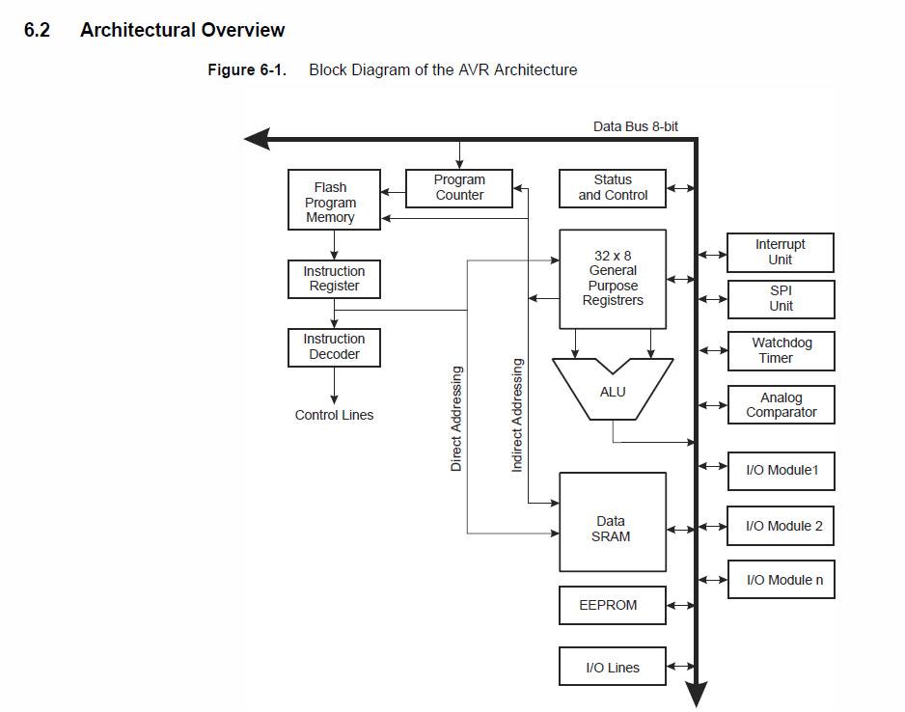
ATMEL 168 Microprocessor

Slide 22
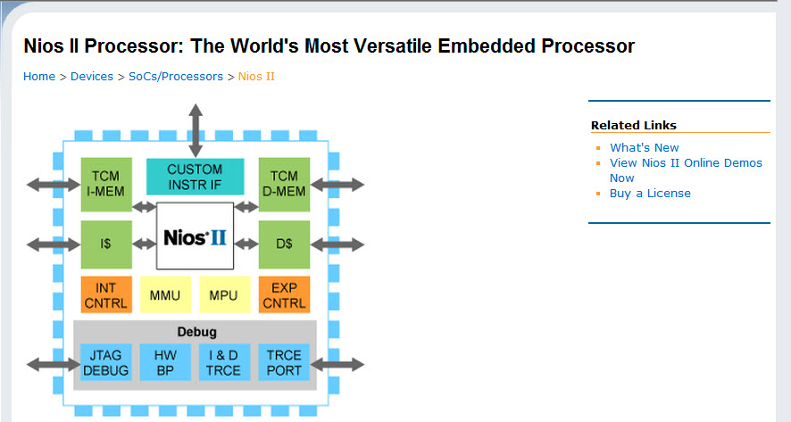
Altera’s ‘Soft’ Processor

Slide 23
Processor Module Layout
Processor
Bottom-up
Implementation
Top-Down
Design
Control
Unit
Datapath
Inst. Memory
Data. Memory
PC
IR
Register File
State Machine
ALU
Control Unit
Datapath

Slide 24
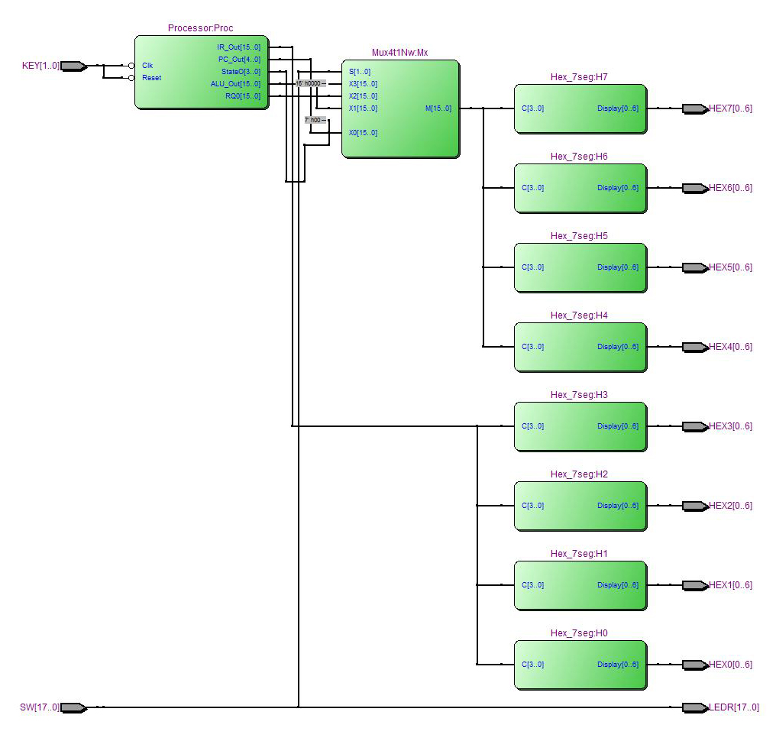
Top Level
Note: Contains Extra Debug Information

Slide 25
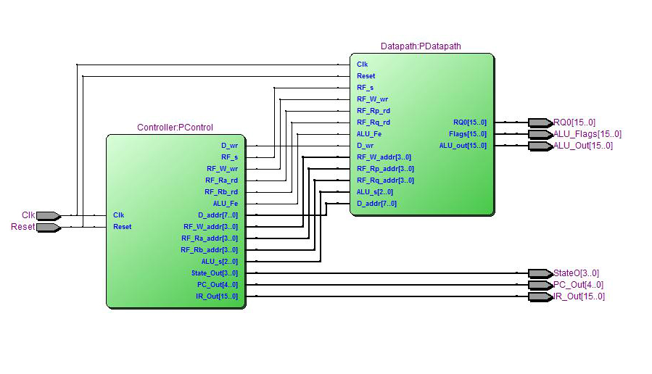
Processor Level
Note: Contains Extra Debug Information

Slide 26
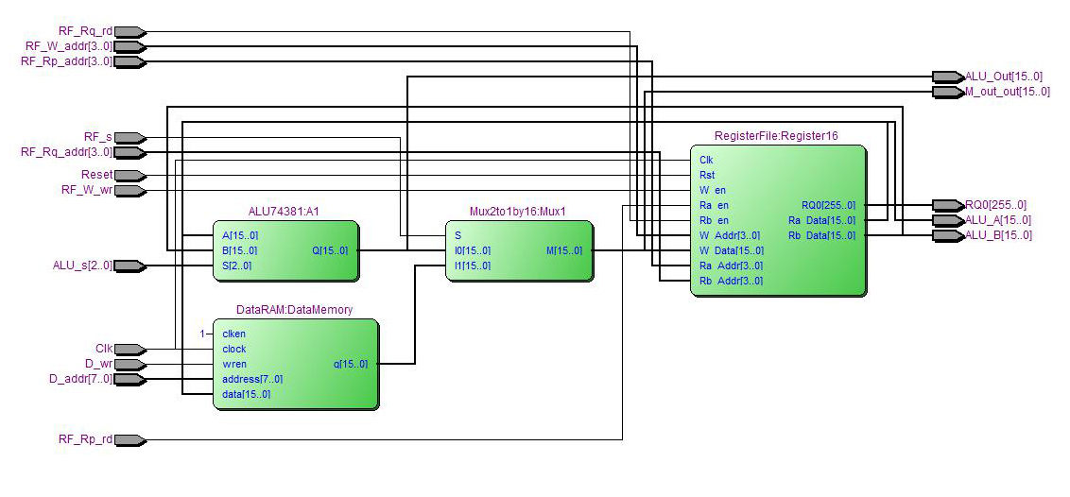
Datapath Level
Note: Contains Extra Debug Information

Slide 27
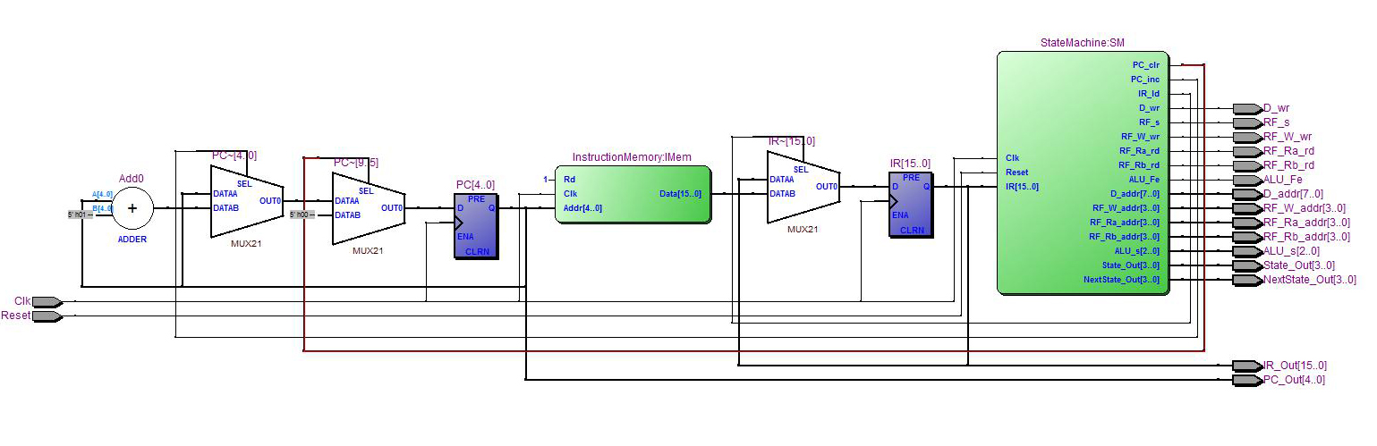
Controller Level
Note: Contains Extra Debug Information

Slide 28
Procedure
Write a module (lowest level).
TEST IT!
Repeat until you have written all low-level modules.
Make sure your state machine is recognized as such by Quartus
Write the modules next level up (Control Unit, Datapath).
TEST THESE!
Write the Processor by instantiating Control Unit module and Datapath module and wiring them together.
At this point you should be able to test your entire processor in ModelSim. Remember you will need to create a ModelSim project not just a work library since you are using LPMs.
Final test for the Processor is running the program and inspecting Data Memory to make sure the correct value is stored in location 5.
NOTE: You can do your unit testing on the DE2 or you can use ModelSim – It’s probably better to test with ModelSim because you can more easily debug in this environment.

